Slide 1
Crime Tracking
Management system

Slide 2
Problem Statement
This project addresses the responsiveness of the police department to the crime reported. The process of investigating a crime follows many phases like assigning a dispatch team to the crime scene, crime scene analysis (blood spatter, forensic), investigation, zeroing on suspect(s), issuing warrant. This process is tedious and requires lot of paperwork. This could be reduced by our proposed crime management system. The intimation to the dispatch team is given by the victim or potential witness of the crime scene, the immediate response to the intimation of crime scene also help the police department to rescue the victim and find the suspect.

Slide 3
Scope of the Project
Our project intends to model an ecosystem of networks and enterprises that are involved in the crime management system.
Each person carries a device which allows him to signal the dispatch unit in the onset of danger. The dispatch unit usually consists of people who receive the message of the imminent persons who are in distress and assign police officer to act on it. This process of dispatch unit is automated here.

Slide 4
Scope of the Project Continued…
The system (autonomous dispatch unit) allocates the nearby dispatch team (police officers) to reach the crime scene based on the location of the crime scene reported.
On the crime scene the analysts (blood Spatter analysts and forensics analysists) interpret to bring about the timing and other details (like DNA, Finger prints, blood sample) of the crime which may lead to find the suspect(s).
Analysts process the information (above mentioned details) collected from the crime scene and provide a report to the Detective.

Slide 5
Scope of the Project Continued…
The detective upon receiving the result look for any potential matches in the criminal database, if found he proceeds with the investigation and update the findings in the system.
If on investigation and sufficient evidence against the suspect, the detective raises request to Lieutenant (Chief of police department) to issue arrest warrant against the suspect.
Lieutenant logins to the system to look into the details of the file and approve the request.

Slide 6
Assumptions
System accessibility restricted only within Unites States (We have shown the implementation of the system in the Massachusetts Network.
Criminal records are perfectly maintained for the criminals using the finger print parameters and the factors determining the DNA sequence of a person.
System will be in compliance with federal and FDA regulations.

Slide 7
USE cases
System admin
Creates network Massachusetts
Creates enterprises (Criminal and Justice)
Creates enterprise admin and provides access.
Enterprise Admin
Manages Organization by creating new Organization under its enterprise
Manages Employee by creating employee for each Organization
Also provides User Account to the employees to access the system.

Slide 8
USE cases
public
Creates Emergency Request for the nearby Police/Investigator to arrive at the requested location.
Have access to the nearby Investigator’s location based on the Shortest path Algorithm.
Investigator
Manages the emergency requests which are automatically assigned from the public organization.
Manages Analyst dispatch request by calling the analyst to arrive at the location.

Slide 9
USE cases
Manages Analyst dispatch request by calling the analyst to arrive at the location.
Manages Enquiry Report Request which will have the enquiry details for the incident.
Manages Commissioner request to get approval for enquiry.
Authorized to use the Smart search once the evidences from Analyst Organization and Lab Organization is included in the Case file.

Slide 10
USE cases
Analyst
Manages Dispatch request from the investigator.
Collects the DNA and Finger Print Samples from the Crime Scene and request for testing to the Lab Organization.
Attaches the Potential Suspect’s Identification details to the Case Files.

Slide 11
USE cases
Laboratory
Manages the requests from the Analyst Organization to process the Identification sings of the Potential suspect or Unidentified Criminal.
Commissioner
Manages the enquiry report requests from the Investigator to approve or reject.
Supervises or oversees the Cases Status

Slide 12
USE cases
Sends the requests to the Justice Enterprise to get Warrants for the Criminals found during the Investigation.
Attorney
Creates Cases for the requests send by the Commissioner to summon the criminal to the Judiciary system.

Slide 13
USE cases
Justice
Manages the requests from the attorney.

Slide 15
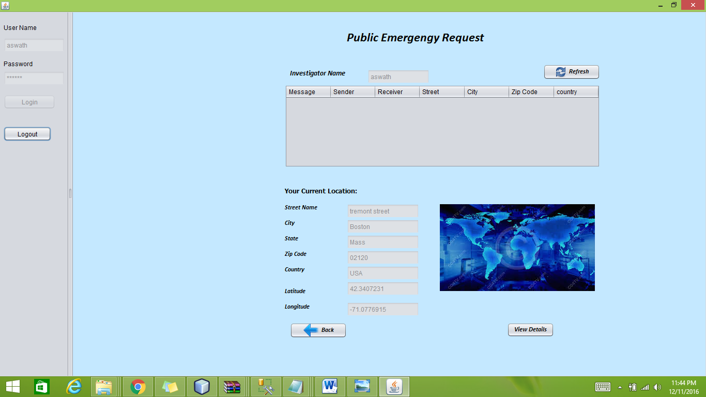

Slide 16
